Slide 1
Organization Opti-Connect Solutions DAshBoard And Report
Organization OptiConnect Solutions
Dashboard & Report

Slide 2
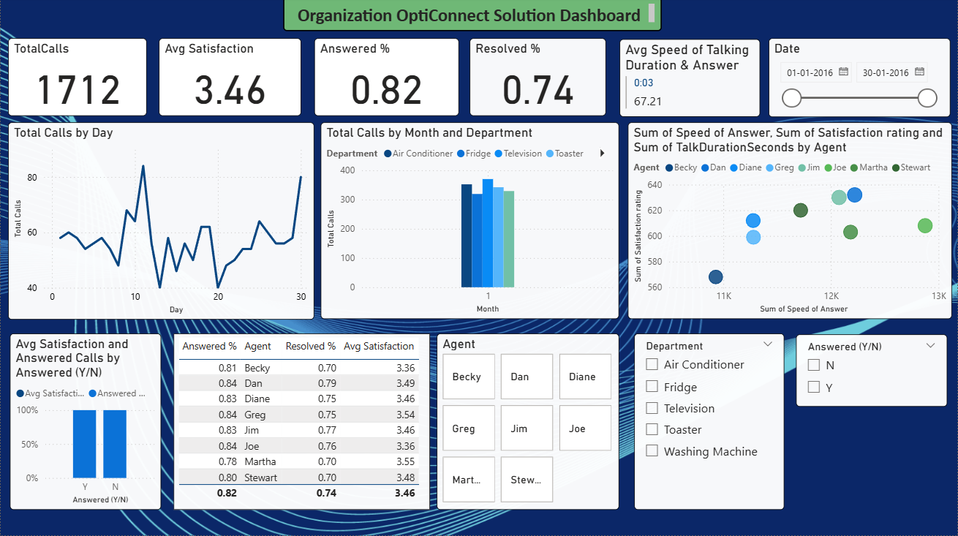
N
Actual view Of the Dashboard

Slide 3
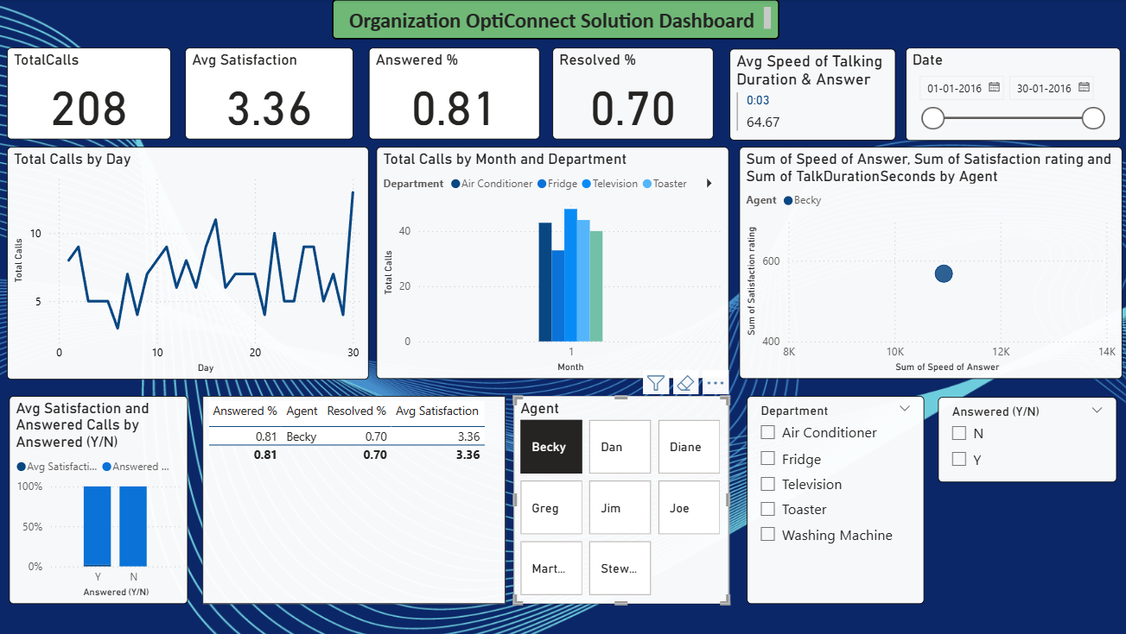
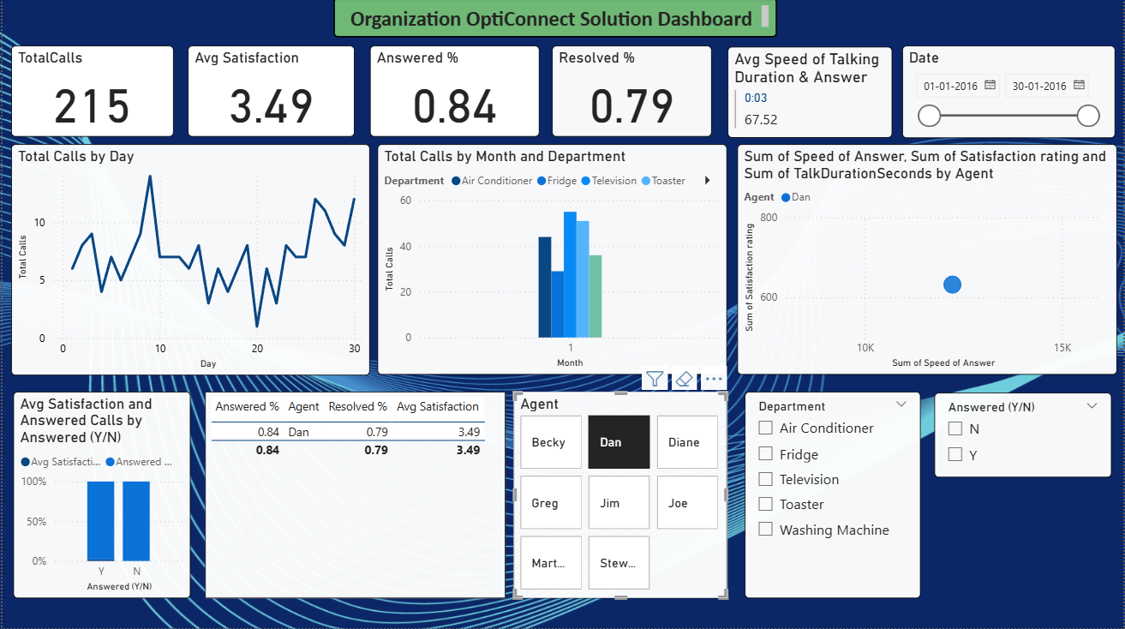
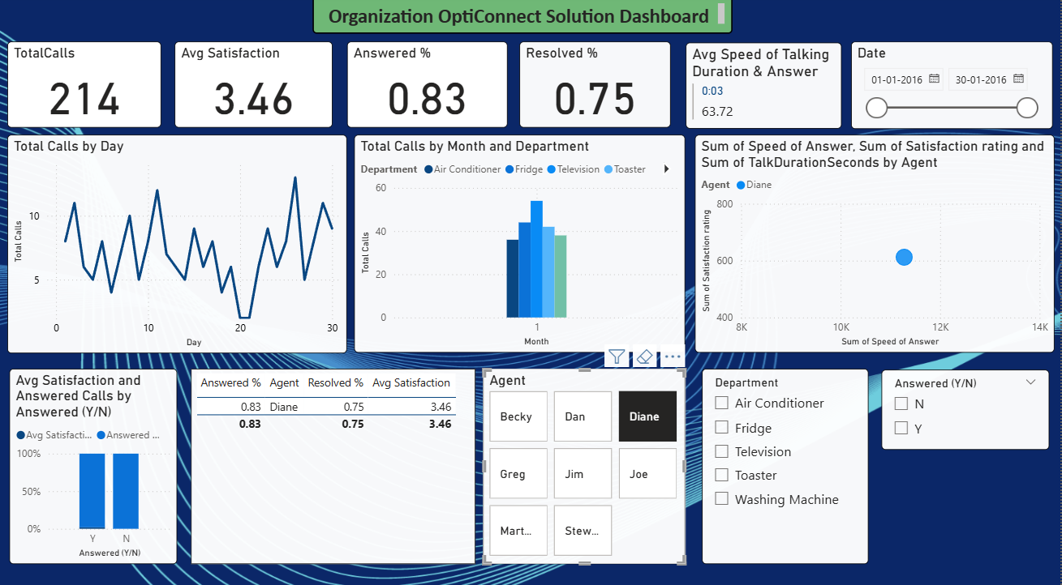
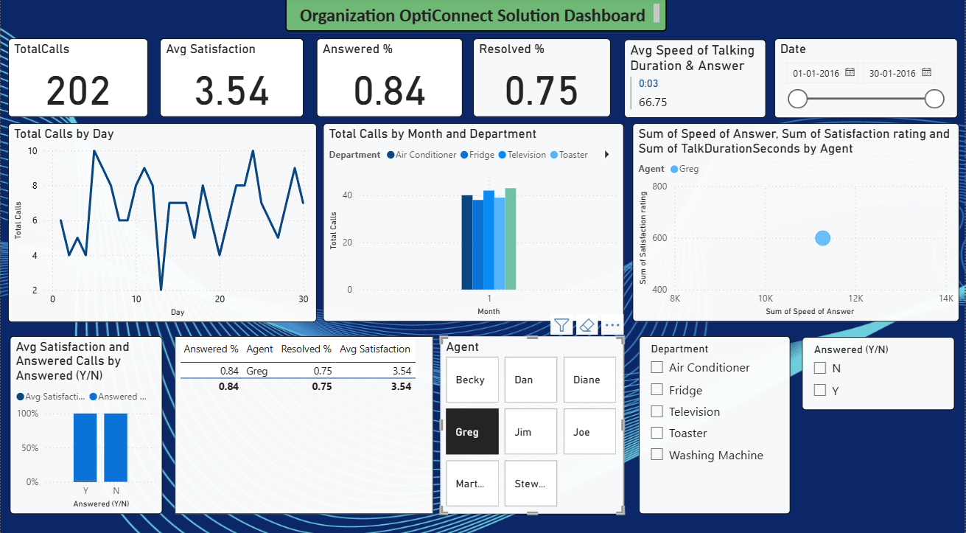

Slide 4
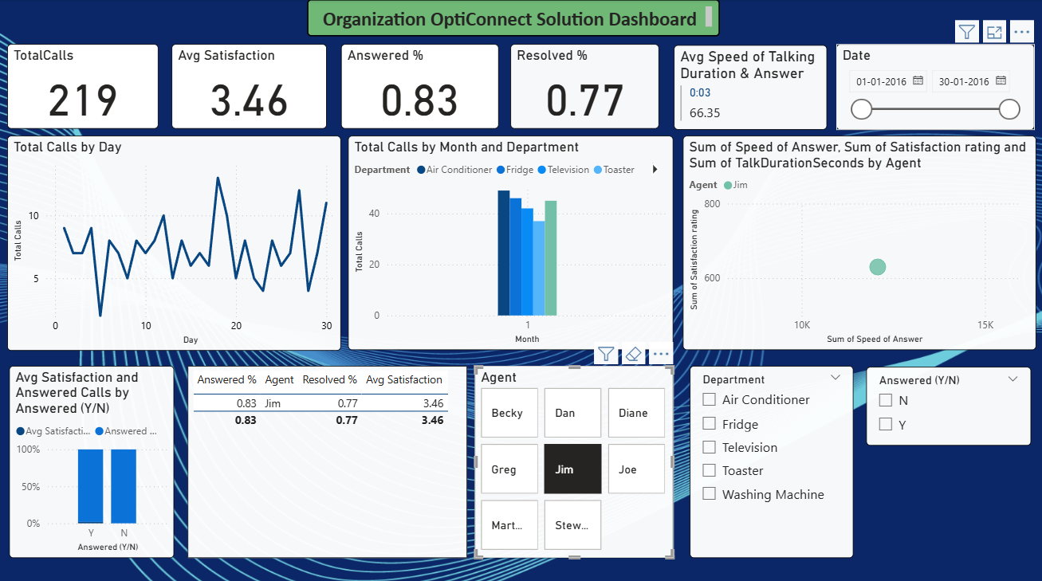
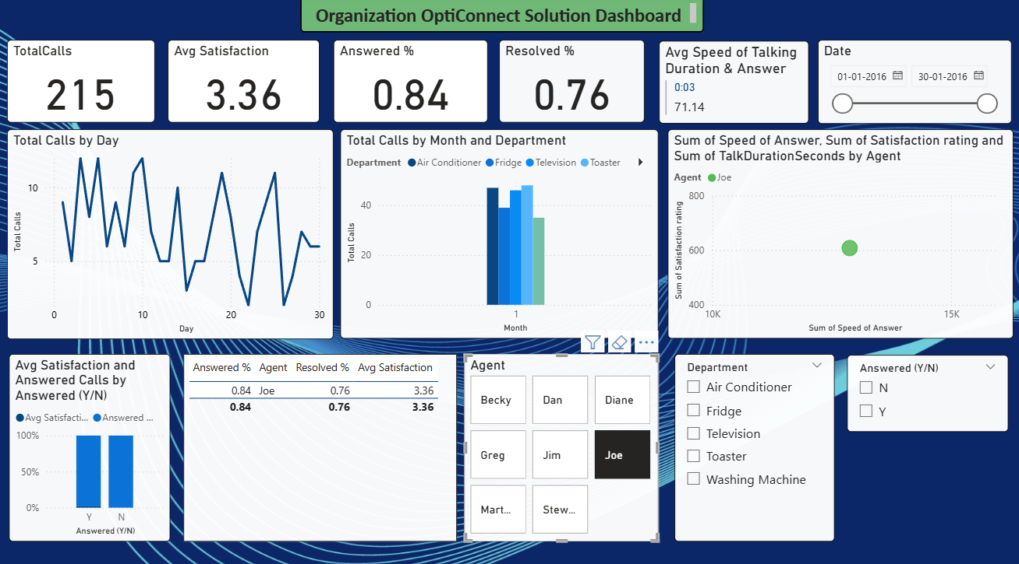
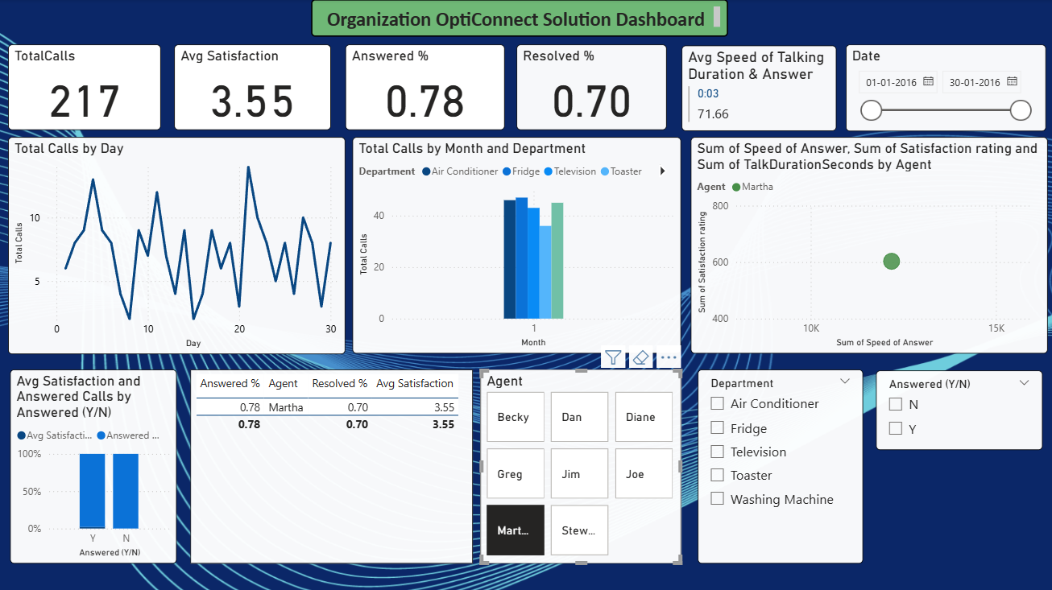
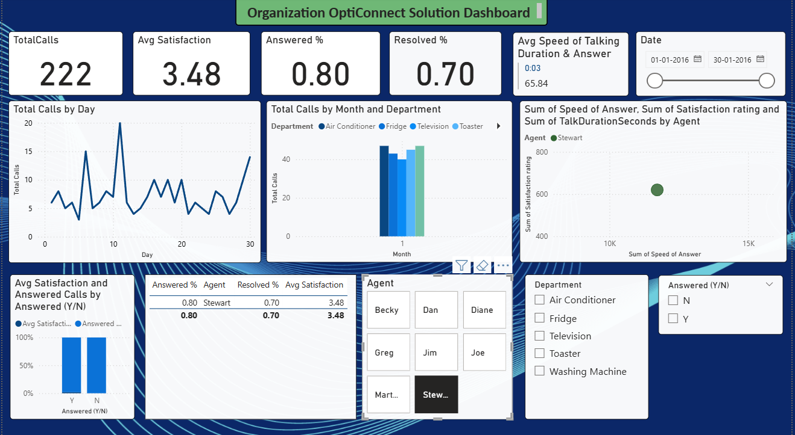

Slide 5
1.Timeliness of Call Response: With a total of 1,712 calls recorded, the Answered Percentage (82%) and an average speed of answer of 3 seconds indicate that calls were largely answered in a timely manner. This suggests that the call center maintained efficient response operations. However, daily call trends revealed fluctuations in call volumes, where mid-month saw a dip, potentially easing agent workload and enabling faster response times during that period. 2. Effectiveness in Issue Resolution: The Resolved Percentage (74%) demonstrates that most customer issues were successfully addressed, reflecting satisfactory agent performance. Agents such as Dan (79%) and Joe (76%) achieved the highest resolution rates, indicating their strong ability to manage and resolve customer concerns effectively. Despite these positive figures, there remains scope to enhance the resolution rate through targeted agent training and knowledge-sharing sessions. 3. Impact of Speed of Answer and Talk Duration on Satisfaction: The average customer satisfaction score of 3.46 out of 5 reflects a moderate level of customer contentment. Analysis of agent-wise data indicates a positive correlation between faster response times and higher satisfaction ratings. Agents who responded more quickly tended to achieve better satisfaction outcomes. Meanwhile, the average talk duration of approximately 67 seconds suggests that while most calls were concise, longer conversations might indicate more complex issues, which could slightly reduce satisfaction if not managed effectively. 4. Patterns and Trends for Optimized Performance: Notable trends were observed across departments and agents. The Fridge and Air Conditioner departments received the highest call volumes, signifying areas that may require additional staffing or workflow optimization. Agents Dan and Joe consistently performed well across all key indicators, making them potential role models for performance benchmarking. Moreover, fluctuating call volumes throughout the month suggest that demand forecasting and dynamic scheduling could help balance workloads and maintain consistent service quality. Conclusion: Overall, the call center exhibits strong operational efficiency, characterized by rapid response times and satisfactory issue resolution. To achieve optimal performance, the organization should focus on improving first-call resolution rates, enhancing agent training, and leveraging data-driven forecasting to manage peak call periods effectively. Such measures would contribute to sustaining higher customer satisfaction and improving the overall quality of service delivery.
Analysis & Findings of the Report

